Slide 1
Applying for a Job with Montgomery County Government (MCG) OHR Recruitment and Selection Division Staff
Reviewed 1/9/24

Slide 2
In This Presentation
Searching and Applying for Jobs
Preparing Your Resume
Tracking Your Application Status
Resources

Slide 3
Searching and Applying for a Job www.WORK4MCG.com

Slide 4
Searching for Jobs
There are two ways to search for jobs:
External Applicants: www.WORK4MCG.com
Current Contractors: Log on to iRecruitment through Employee Self-Service
We will talk about External Candidates first and then current employees and contractors.

Slide 5
Notes:
Job Openings: Search Jobs; Recruitment Home
News and Events: Career Fairs; Community Briefings
Benefits and Pay: Total Rewards

Slide 6
Notes:
Executive Positions: Highlighted Director and higher-level positions
Employment Initiatives: Internships; Unique Programs (for people with disabilities); Hiring Preference; Reasonable accommodations
Career Resources: Briefings and classes; Resume preparation tips; Job Application guide; Videos
Quick Links (under More Links): Equivalencies; Hiring Preference; Job Classification Plan; Reasonable Accommodations; Resume Preparation tips

Slide 7
Searching for Jobs (External)
Tip: Register first for an AccessMCG Extranet account – If you choose this option, you will be prepared to apply as soon as you see an ad that interests you. Click on the Recruitment Home tab.

Slide 8
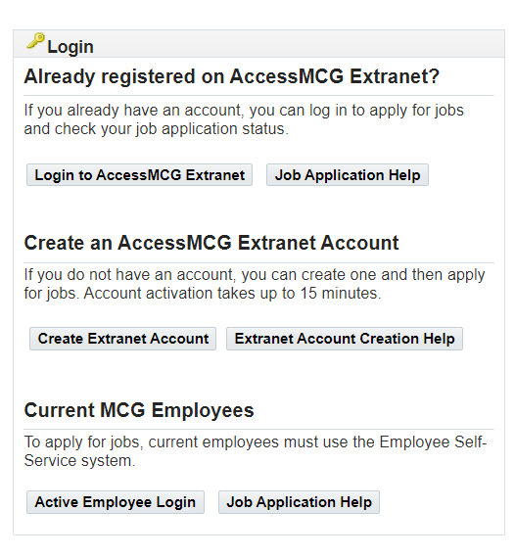
Searching for Jobs (External)
After clicking the Recruitment Home tab – click on the “Create Extranet Account” button and follow the online steps.

Slide 9
Searching for Jobs (Contractors)
To access iRecruitment:
Log in to the AccessMCG ePortal for employees: https://eportal.montgomerycountymd.gov
Click Employee Self-Service.
Click Go to Employee Self-Service.
Click MCG HR iRecruitment Employee.
Click Search Jobs tab on top left

Slide 10
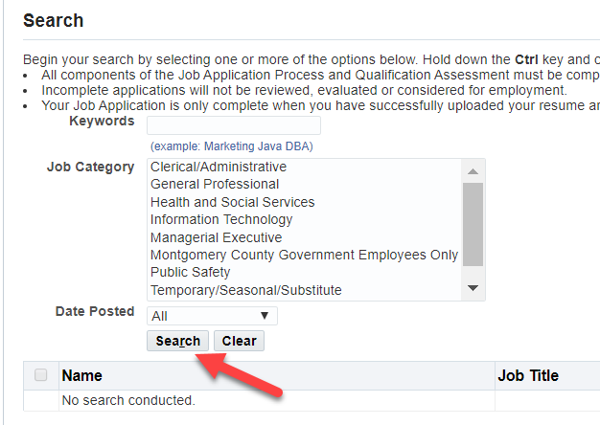
Searching for Jobs
Back on the Search Jobs tab, click Search to see all the jobs currently available.

Slide 11
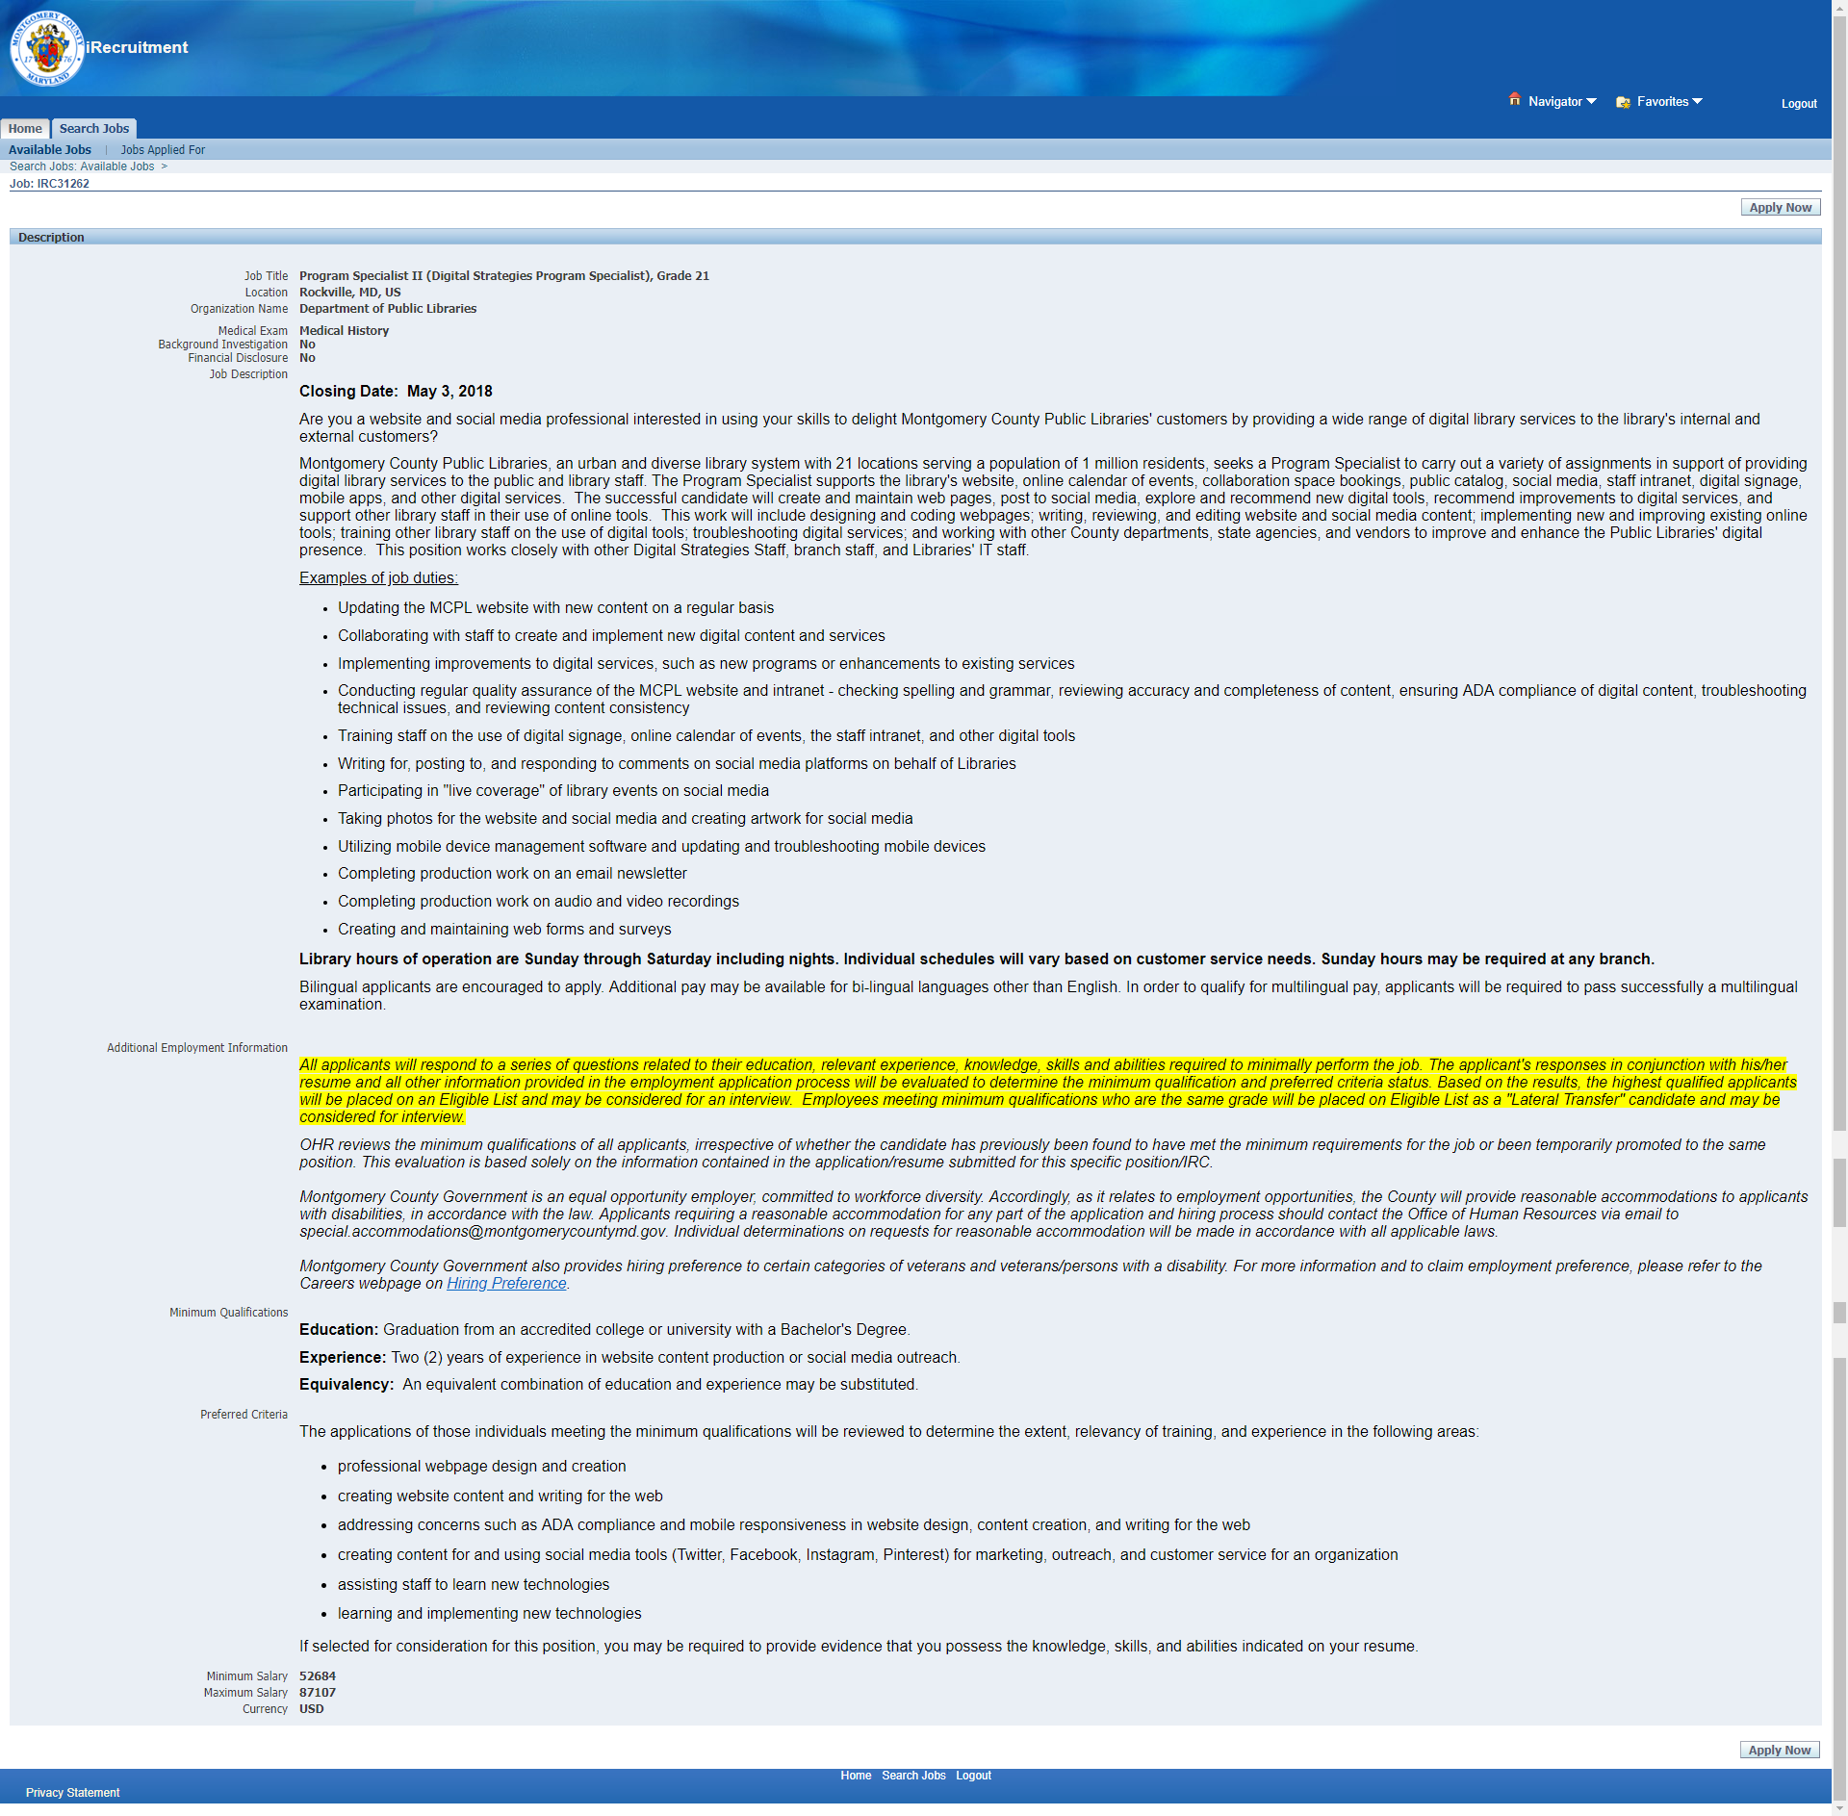
Searching for Jobs (cont.)
Read the advertisement, and then print it so that you can reference it later. Once the job’s closing date has passed, the advertisement is no longer displayed.
If you are logged in, you can click the Apply Now button if you are ready to apply.

Slide 12
Important Tips
You cannot remain on a particular page for more than 30 minutes without activity or you will time out. If you time out, log in again and complete the application process.
The system allows only one document to be uploaded. If you would like to upload a cover letter with your resume, you need to combine them into one PDF and upload them as one document.
Once you upload your document and click next, you cannot delete it.

Slide 13
Priority Consideration for Initial Appointment to a County Merit System Position
If you wish to claim any of the hiring preferences for an MCG merit system position, you must answer the Hiring Preference online questions as part of your application. If you are placed in the highest rating category on the Eligible List for positions that you apply for, you will be contacted to obtain the required confirmation documents (see Resources at end of presentation). You must provide those documents within 14 calendar days of notification.
Priority consideration is given to the following persons in the following order:
a veteran with a disability
an equal preference for a veteran without a disability and for a person with a disability
Hiring Preference Details and Required Documentation –
www.montgomerycountymd.gov/HR
> MCG Careers > Employment Initiatives > Hiring Preferences and More

Slide 14
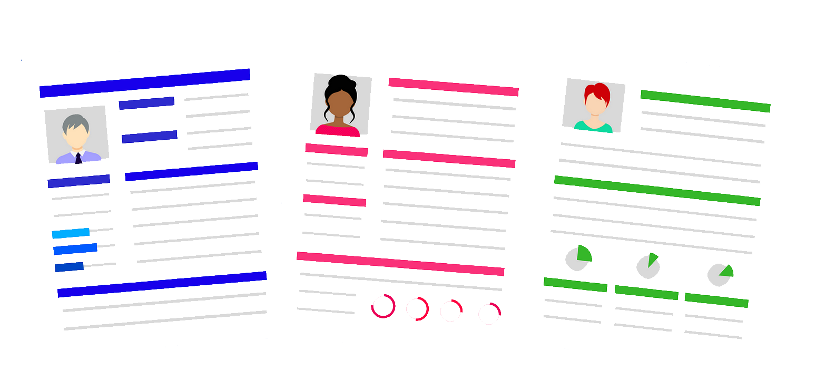
Preparing Your Resume

Slide 15
Preparing Your Resume
Tip 1: Review the job’s minimum qualifications and, if applicable, the interview criteria, in the job announcement so that you can address them in your resume.
Tip 2: Ensure your resume thoroughly and accurately reflects your experience,
training, skills and education.
Tip 3: Ensure your resume contains the following information:
Your name, phone number and email address (home address is optional)
Your education level:
Name of the institute and degree earned (e.g., High School, GED, Bachelor’s Degree, Masters’ Degree, PHD, JD, etc.)
Degree from outside the United States will be accepted at face value at time of application but must be validated by a credential evaluation organization if you are selected. (examples: World Education Services, National Association of Credential Evaluation Services)
Number of credit hours earned if no degree was obtained; refer to Equivalencies for Education and Experience.
Continued…

Slide 16
Preparing Your Resume
Tip 3 (continued): Ensure your resume contains the following:
Your work history in reverse chronological order (e.g., 2016, 2015, 2014, etc.)
Title of position held and month/year the position started/ended (e.g., 12/00 - 12/02; if you worked part-time, list it as 12/00 – 12/02 20 hours/week)
Whether you were working in a full-time or part-time capacity
List of duties and responsibilities associated with each position
Trainings, licensures, certifications (include credit hours)
Multilingual skills
List of languages you speak fluently (other than English)
Volunteer hours (agency, location, hours, dates, type of work)

Slide 17
Tracking Your Application Status

Slide 18
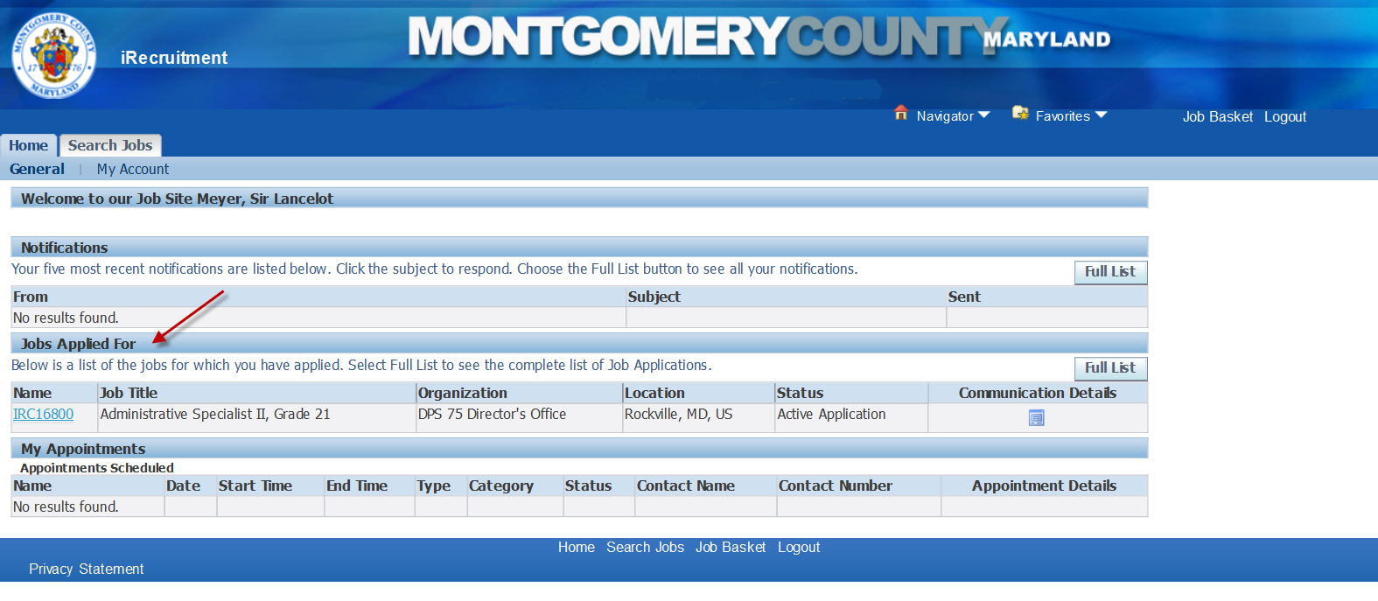
Check In Online
After you apply, go to the Jobs Applied For section to track the status changes of your various applications.

Slide 19
Summary Highlights of This Presentation
Review the Minimum Qualifications and Interview Criteria and ensure that your resume reflects all relevant work experience to support your knowledge, skills, and abilities related to these qualifications.
Apply for a position as early as possible to avoid missing the deadline and allow proper time for resume preparation and submission.
Incomplete applications will not be reviewed, evaluated or considered for employment.
Applications for current job openings are not accepted after the closing date.​

Slide 20
Resources

Slide 21
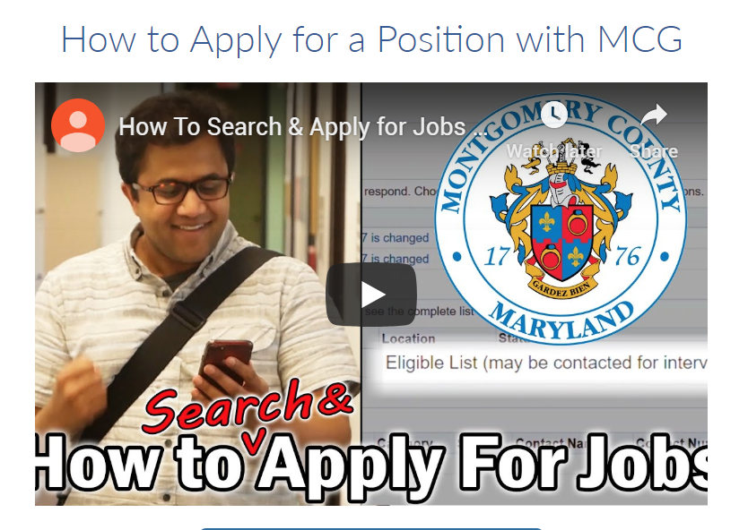
Resources
www.WORK4MCG.com
Videos on How to Apply and more
Quick Links to:
Classification Specifications:
Equivalencies
How to Contact Us

Slide 22
Even More Resources…
Check out these step-by-step guides at www.WORK4MCG.com (select Career Resources):
Search Jobs Guide
How to Apply Guide
How to Track Application Status Guide

Slide 23
And Even More Resources! (through Montgomery County Public Libraries)
LinkedIn Learning – A leading online learning platform that helps anyone learn business, software, technology and creative skills to achieve personal and professional goals.
Northstar – Improve your basic digital literacy skills in 3 areas: essential computer skills, essential software skills, and using technology in daily life.
Udemy – Top-rated courses from Udemy that offer upskilling in the areas of business, tech, and personal development across 75+ different categories.

Slide 24
And Yet Even More Resources! (through Montgomery County Public Libraries)
Brainfuse – JobNow – Live online coaching and resources for resume, interview prep and career planning.
Brainfuse – VetNow – Benefits, career, and academic assistance support for Veterans
LearningExpress Library – Offers job search and workplace skills improvement; skill building in reading, writing, math, and basic science; career certification and licensure exam prep; college and grad school entrance test prep; GED® test prep; and more.

Slide 25
Questions/Answers

Slide 26
Mike Sirbaugh Human Resources Specialist michael.sirbaugh@montgomerycountymd.gov 240-777-5021

