Slide 1


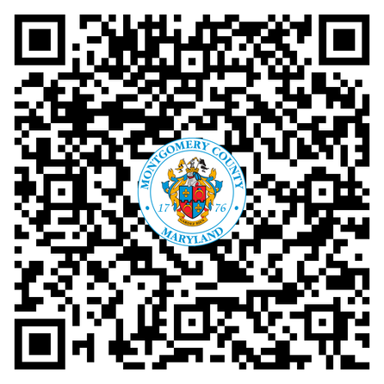

Montgomery County Government
You’re going to love it here!
Visit Our Website
work4mcg.com

Slide 2












Find Your Next Dream Job
Clerical/Administrative
Health & Social Services
Administrative Assistant and Aides
Nurses, Therapists, Caseworkers,
Social Workers, Nurse Practitioners, Community Service Aides
General Professional
Public Safety
Data Analysts, Program and Project Managers, Attorneys, Engineers, Inspectors, Librarians, etc.
911 Call Takers, Correctional Officers, Police Officers, Deputy Sheriffs
Managerial
Temporary/Seasonal/Substitute
Operations Managers and Division Chiefs
Recreation Assistants, Election Aides, Warehouse Workers
Information Technology
Trades and Labor
IT Specialists and Technicians
Truck Drivers, Technicians, HVAC Mechanics, Auto Mechanics, Plumbers, Store Clerks

Slide 3





We value and care for our employees
Health care coverage
Paid leave & perks
Retirement plans
Wellness program
Commuter programs
Health
Dental
Vision
Prescription Drug
Healthcare FSA
Life Insurance
Retire with health insurance!
Sick leave
Annual leave
Parental leave
Tuition Assistance
Housing Down Payment Assistance
Public Safety Pensions
Employer Contributions
Deferred Compensation
Wellness classes
Self-care programs
Employee assistance
Financial planning
Legal support
Concierge services
Earn money for taking charge of your health!
Capital Bike Share discount
Commuter savings program
Free Ride-On bus travel with Employee ID!

Slide 4

Start Your MCG Journey Today
We are excited for you to join our teams in service to Montgomery County and creating more inclusive and accessible County Government.
Visit work4mcg.com.
Learn more about our employee experience, programs and total rewards.
Click on “Job Openings” to start your journey with us today.
Search & Apply
Over 100 job opportunities
waiting for you to discover.
Find your next dream job today!

Slide 5







Stay Connected With Us
@work4mcg
Montgomery County Government
www.work4mcg.com
ohr@montgcomerycountymd.gov
240-777-0311: MC311

